Slide 1
1

Slide 2
BA 310 Principles of Marketing
Dr. Keven Malkewitz
  Office: 203 West House
  malkewik@wou.edu
Office Hours:
  Tues: 7-8 am, 12:30-2:30 pm
  Thurs: 7-8 am
  …and by Appointment if Needed

Slide 3
Open Floor
All Stuff on MOODLE (Lectures, Syllabus, Schedule)
  You Should be Able to Get It
  Questions?
Grade Sheet
  Last FIVE digits of Student Number
  Check to Make Sure All OK…
Questions?

Slide 4
Last Class Review
Introductory Lecture
  Text
  Principles
  Policies
Overview of Marketing (“Foreshadowing”)
Five-Minute Drill on “Four P’s”
Prep for Next Class

Slide 5
Today’s Class Overview
Football 4 P’s
Creating and Capturing Customer Value (Chapter 1)
Five-Minute Drill
“What Did I Learn Today?” Writing Exercise

Slide 6
Chapter One
Marketing: Creating and Capturing Customer Value

Slide 7

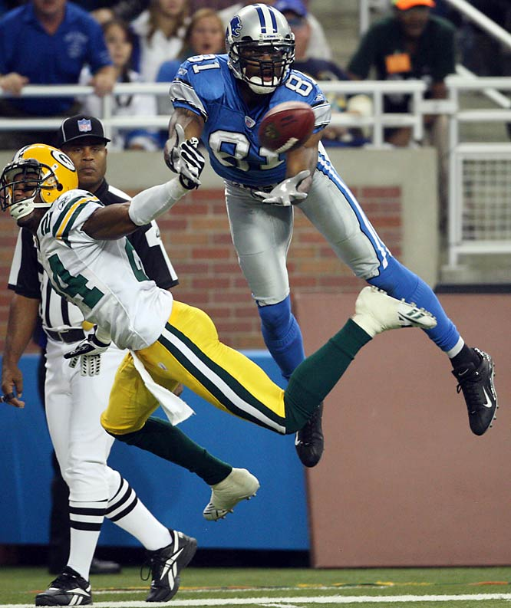
Pro Football 4 P’s
Product
Price
Promotion
Place

Slide 8
Creating and Capturing Customer Value
Topic Outline
What Is Marketing?
Understand the Marketplace and Customer Needs
Designing a Customer-Driven Marketing Strategy
Preparing an Integrated Marketing Plan and Program
Building Customer Relationships
Capturing Value from Customers
The Changing Marketing Landscape

Slide 9

What Is Marketing?
Marketing is a process by which companies create value for customers and build strong customer relationships to capture value
from customers in
return
Notes:
Note to Instructor:
The text gives some excellent examples of companies that are successful in marketing. These examples include:
Wal-Mart which has become the world’s largest retailer—and the world’s largest company—by delivering on its promise, “Save money. Live Better.”
At Disney theme parks, “imagineers”work wonders in their quest to “make a dream come true today.”
Apple fulfills its motto to “Think Different” with dazzling, customer-driven innovation that captures customer imaginations and loyalty. Its wildly successful iPod grabs more than 70 percent of the music player market; its iTunes music store captures nearly 90 percent of the song download business.
Discussion Question
Ask students for other examples of either national or local companies who are excellent at marketing and ask how they reflect the definition given in this slide.

Slide 10
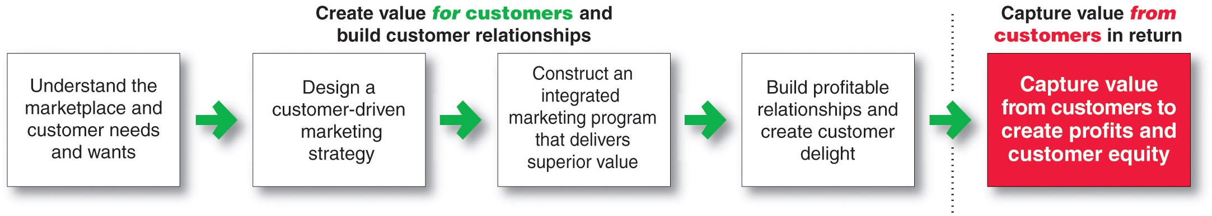
What Is Marketing?
The Marketing Process

Slide 11
Understanding the Marketplace and Customer Needs
Core Concepts
Customer needs, wants, and demands
Market offerings
Value and satisfaction
Exchanges and relationships
Markets

Slide 12
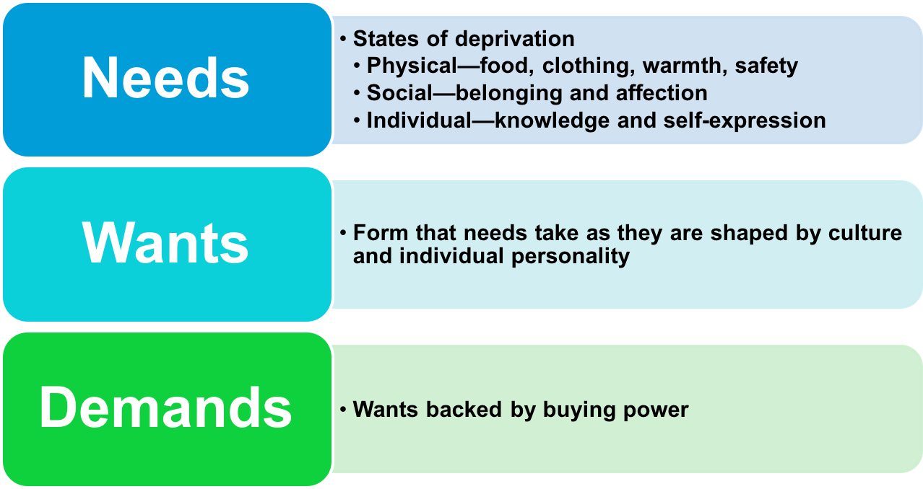
Understanding the Marketplace and Customer Needs
Customer Needs, Wants, and Demands

Slide 13

Understanding the Marketplace and Customer Needs
Market offerings are some combination of products, services, information, or experiences offered to a market to satisfy a need or want
Marketing myopia is focusing only on existing wants and losing sight of underlying consumer needs

Slide 14
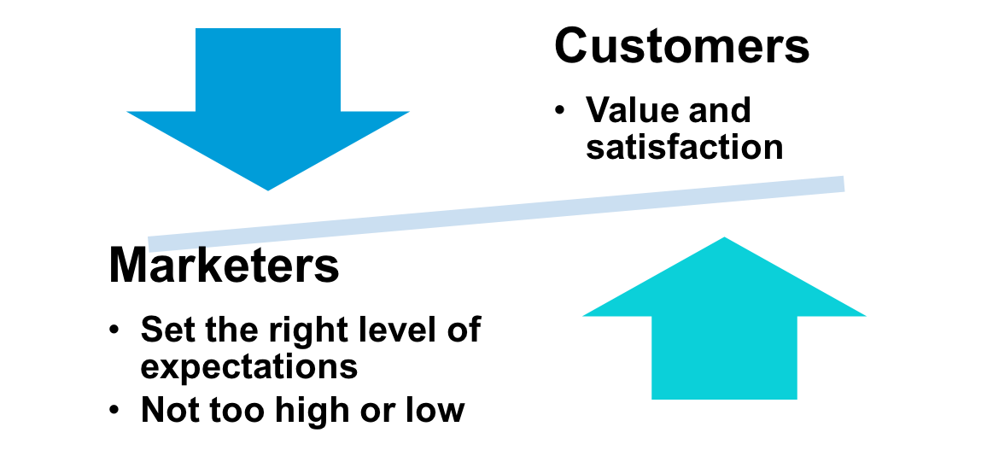

Understanding the Marketplace and Customer Needs
Customer Value and Satisfaction
Expectations
Notes:
Note to Instructor:
This Web link connects to online shoe retailer zappos.com. You can link to the site and see how this retailer creates value for the consumer. Explore features including customer reviews, online LIVE customer service, free shipping (including returns). Ask students what other online retailers deliver exceptional value and satisfaction.
Discussion Question
Why do marketer’s not always understand customer needs? How can they better identify customer needs?
Marketer’s often work in a vacuum and do not consider the customer’s needs as much as they should. Future chapters will talk about market research and marketing information, important tools for understanding customer’s needs. Students might be familiar with survey research or focus groups as techniques for gathering information or they might be asked for their zip code when they purchase in certain retailers

Slide 15
Understanding the Marketplace and Customer Needs
Exchange is the act of obtaining a desired object from someone by offering something in return
Notes:
Note to Instructor:
Marketing consists of actions taken to build and maintain desirable exchange relationships with target audiences involving a product, service, idea, or other object.
Beyond simply attracting new customers and creating transactions, the goal is to retain customers and grow their business with the company.

Slide 16
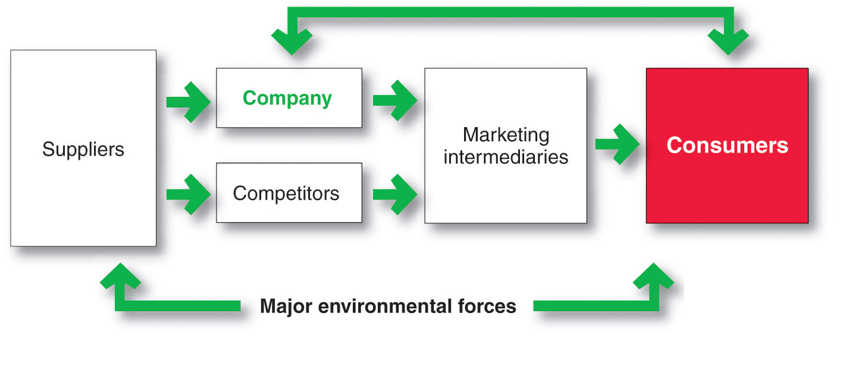
Understanding the Marketplace and Customer Needs
Markets are the set of actual and potential buyers of a product

Slide 17
Designing a Customer-Driven Marketing Strategy
Marketing management is the art and science of choosing target markets and building profitable relationships with them
  What customers will we serve?
  How can we best serve these customers?

Slide 18
Designing a Customer-Driven Marketing Strategy
Selecting Customers to Serve
Market segmentation refers to dividing the markets into segments of customers
Target marketing refers to which segments to go after
Notes:
Note to Instructor:
The link is to a Samsung phone called jitterbug. Their phones are very easy to use and are targeted to older users. You can click to the site and ask the students who they believe the target market would be for the product.

Slide 19
Designing a Customer-Driven Marketing Strategy
Selecting Customers to Serve
Demarketing is marketing to reduce demand temporarily or permanently; the aim is not to destroy demand but to reduce or shift it

Slide 20
Designing a Customer-Driven Marketing Strategy
Choosing a Value Proposition
The value proposition is the set of benefits or values a company promises to deliver to customers to satisfy their needs

Slide 21
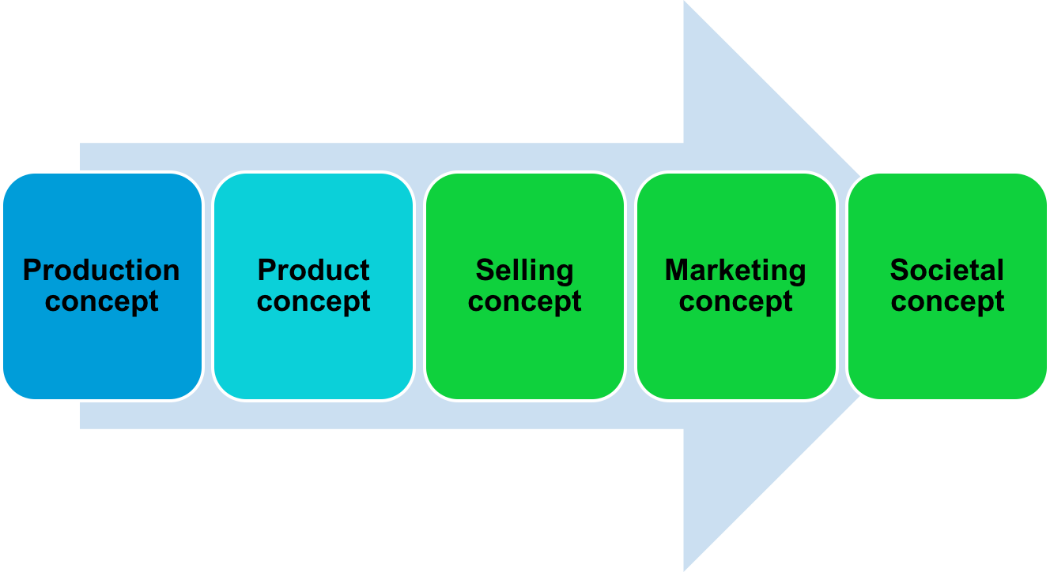
Designing a Customer-Driven Marketing Strategy
Marketing Management Orientations

Slide 22
Designing a Customer-Driven Marketing Strategy
Marketing Management Orientations
Production concept is the idea that consumers will favor products that are available or highly affordable

Slide 23
Designing a Customer-Driven Marketing Strategy
Marketing Management Orientations
Product concept is the idea that consumers will favor products that offer the most quality, performance, and features. Organization should therefore devote its energy to making continuous product improvements.

Slide 24
Designing a Customer-Driven Marketing Strategy
Marketing Management Orientations
Selling concept is the idea that consumers will not buy enough of the firm’s products unless it undertakes a large scale selling and promotion effort

Slide 25

Designing a Customer-Driven Marketing Strategy
Marketing Management Orientations
Marketing concept is the idea that achieving organizational goals depends on knowing the needs and wants of the target markets and delivering the desired satisfactions better than competitors do

Slide 26
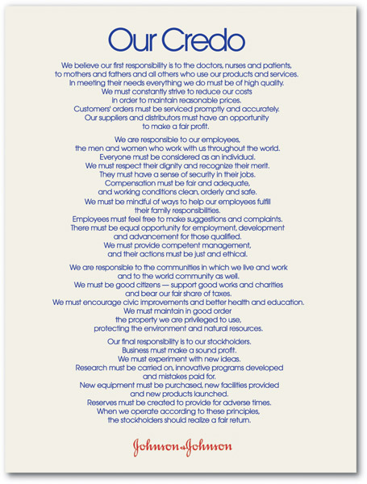
Designing a Customer-Driven Marketing Strategy
Marketing Management Orientations
Societal marketing concept is the idea that a company should make good marketing decisions by considering consumers’ wants, the company’s requirements, consumers’ long-term interests, and society’s long-run interests
Notes:
Discussion Questions
What companies can you identify with social Marketing?
What do these companies do that ties to the societal marketing concept?
Students might be familiar with many different companies that practice societal marketing through their Corporate Social Responsibility (CSR) initiatives. Students might be familiar with local retailers who are also involved in societal marketing. (Target, TOMS shoes). They will note that these companies donate, contribute, or offer services to charities and not-for-profit organizations.

Slide 27
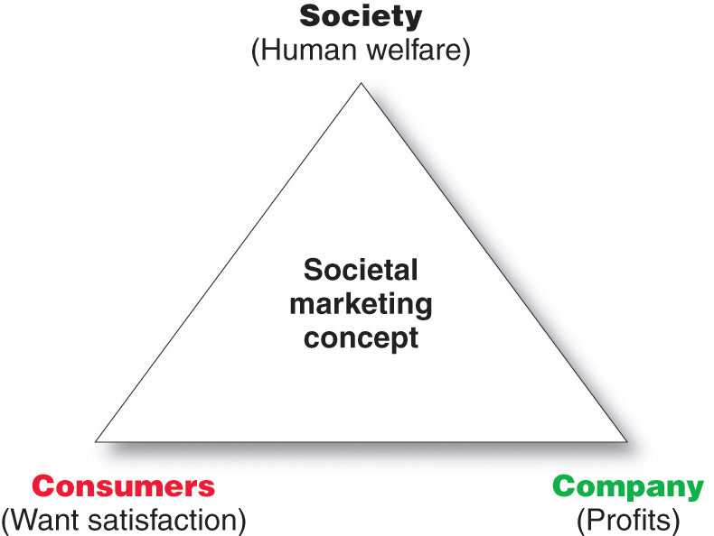
Designing a Customer-Driven Marketing Strategy
Notes:
Note to Instructor
This slide shows companies should balance three considerations in setting their marketing strategies.
Johnson & Johnson does this well. Johnson & Johnson would rather take a big loss than ship a bad batch of one of its products. Consider the tragic tampering case in which eight people died in 1982 from swallowing cyanide-laced capsules of Tylenol, a Johnson & Johnson brand. Although Johnson & Johnson believed that the pills had been altered in only a few stores it recalled all of its product and launched an information campaign to instruct and reassure consumers. The recall cost the company $100 million in earnings.
In the long run, however, the company’s swift recall of Tylenol strengthened consumer confidence and loyalty, and today Tylenol remains one of the nation’s leading brands of pain reliever.
Discussion Question
Ask students about other companies that have had serious problems with their products? How have these companies bounced back?

Slide 28
Preparing an Integrated Marketing Plan and Program
The marketing mix is the set of tools (four Ps) the firm uses to implement its marketing strategy. It includes product, price, promotion, and place.
Integrated marketing program is a comprehensive plan that communicates and delivers the intended value to chosen customers.

Slide 29

Building Customer Relationships
Customer Relationship Management (CRM)
The overall process of building and maintaining profitable customer relationships by delivering superior customer value and satisfaction

Slide 30
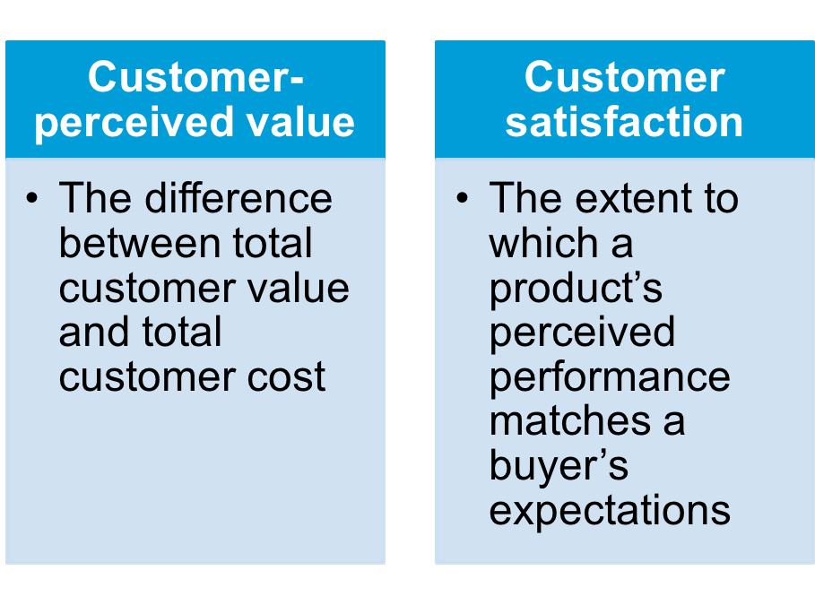
Building Customer Relationships
Relationship Building Blocks: Customer Value and Satisfaction

Slide 31
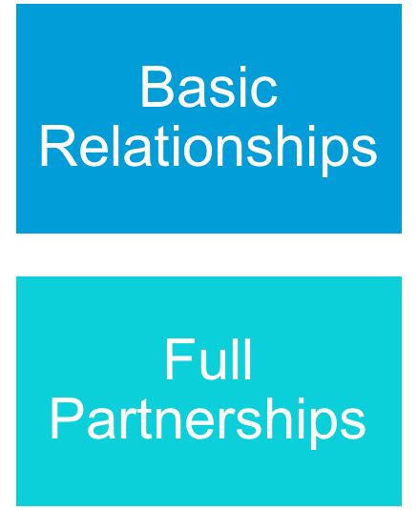
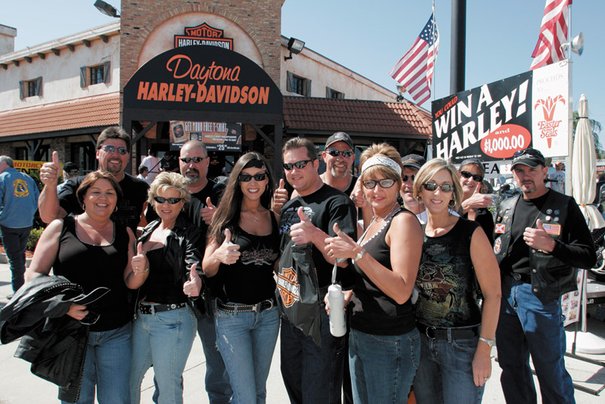
Building Customer Relationships
Customer Relationship Levels and Tools
Notes:
Note to Instructor
Basic Relationships are often used by a company with many low-margin customers For example, Procter & Gamble does not phone or call on all of its Tide consumers to get to know them personally. Instead, P&G creates relationships through brand-building advertising, sales promotions, and its Tide FabricCare Network Web site (www.Tide.com).
Full Partnerships are used in markets with few customers and high margins, sellers want to create full partnerships with key customers. For example, P&G customer teams work closely with Wal-Mart, Safeway, and other large retailers.
Discussion Question
Ask students what frequency or club marketing programs they belong to and why?

Slide 32
Building Customer Relationships
The Changing Nature of Customer Relationships
Relating with more carefully selected customers uses selective relationship management to target fewer, more profitable customers
Relating more deeply and interactively by incorporating more interactive two way relationships through blogs, Websites, online communities and social networks
Notes:
Note to Instructor
This will be a point for a lively discussion.
Discussion Question
Ask students how marketers have used facebook, myspace, linkedin or other social networks for marketing purposes. Ask them about YouTube and how that has changed marketing.

Slide 33
Building Customer Relationships
Partner relationship management involves working closely with partners in other company departments and outside the company to jointly bring greater value to customers

Slide 34
Building Customer Relationships
Partner Relationship Management
Partners inside the company is every function area interacting with customers
  Electronically
  Cross-functional teams
Partners outside the company is how marketers connect with their suppliers, channel partners, and competitors by developing partnerships

Slide 35
Building Customer Relationships
Partner Relationship Management
Supply chain is a channel that stretches from raw materials to components to final products to final buyers
Supply management
Strategic partners
Strategic alliances

Slide 36
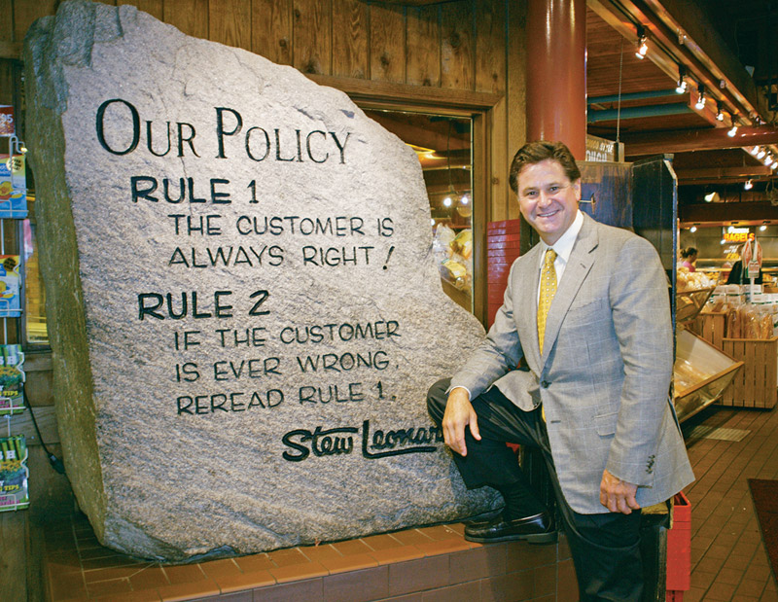
Capturing Value from Customers
Creating Customer Loyalty and Retention
Customer lifetime value is the value of the entire stream of purchases that the customer would
make over a
lifetime of
patronage
Notes:
Note to Instructor
Stew Leonard’s is an interesting example. Stew Leonard, who operates a highly profitable four-store supermarket in Connecticut and New York, says that he sees $50,000 flying out of his store every time he sees a sulking customer. Why? Because his average customer spends about $100 a week, shops 50 weeks a year, and remains in the area for about 10 years. If the marketing process, the company creates value for target customers and builds strong relationships with them. To keep customers coming back, Stew Leonard’s has created the “Disneyland of dairy stores.” Rule 1—the customer is always right. Rule 2—If the customer is ever wrong, reread Rule 1.
You can find videos of Leonard’s stores on youtube.com which will give the students an idea of the atmosphere.
Discussion Question
Ask students if they know of other retailers build this kind of exciting environment.

Slide 37
Capturing Value from Customers
Growing Share of Customer
Share of customer is the portion of the customer’s purchasing that a company gets in its product categories

Slide 38

Capturing Value from Customers
Customer equity is the total combined customer lifetime values of all of the company’s customers

Slide 39

Capturing Value from Customers
Building Customer Equity
Building the right relationships with the right customers involves treating customers as assets that need to be managed and maximized
Different types of customers require different relationship management strategies
  Build the right relationship with the right customers
Notes:
Note to Instructor
A visit to the Coke Web site always offers examples of building customer equity. They usually have a unique way of engaging the customer whether it be online games, music studios, or virtual worlds.

Slide 40
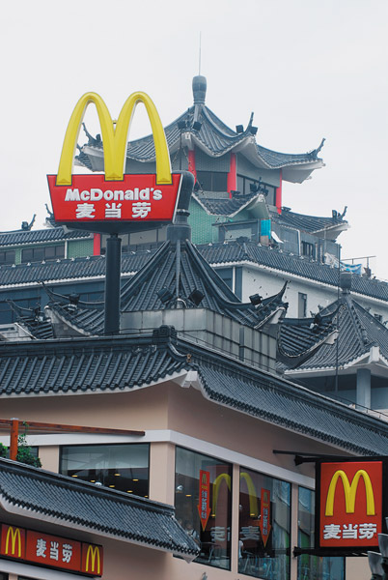
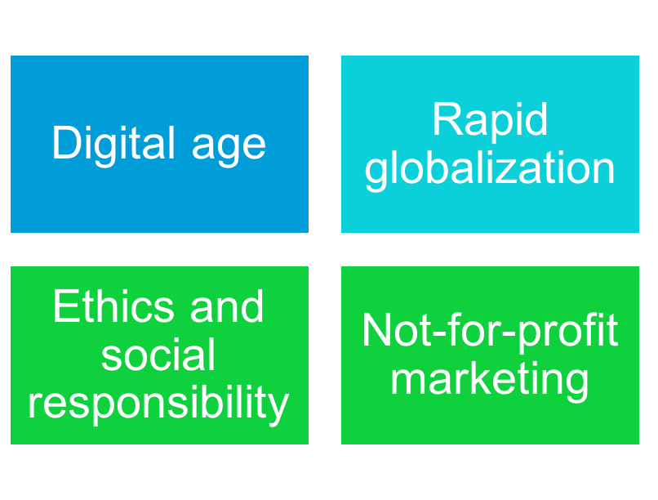
The Changing Marketing Landscape
Major Developments
Notes:
Notes to Instructor
This is a good slide to prompt discussion on personal observations and experiences.
Discussion Questions
Ask if students are from other countries and how consumers and marketers differ in their country.
Have students reflect on how marketers are integrating social responsibility in their marketing messages.
Probe to see if students believe there are differences in marketing for a not-for-profit versus a for-profit company.

Slide 41
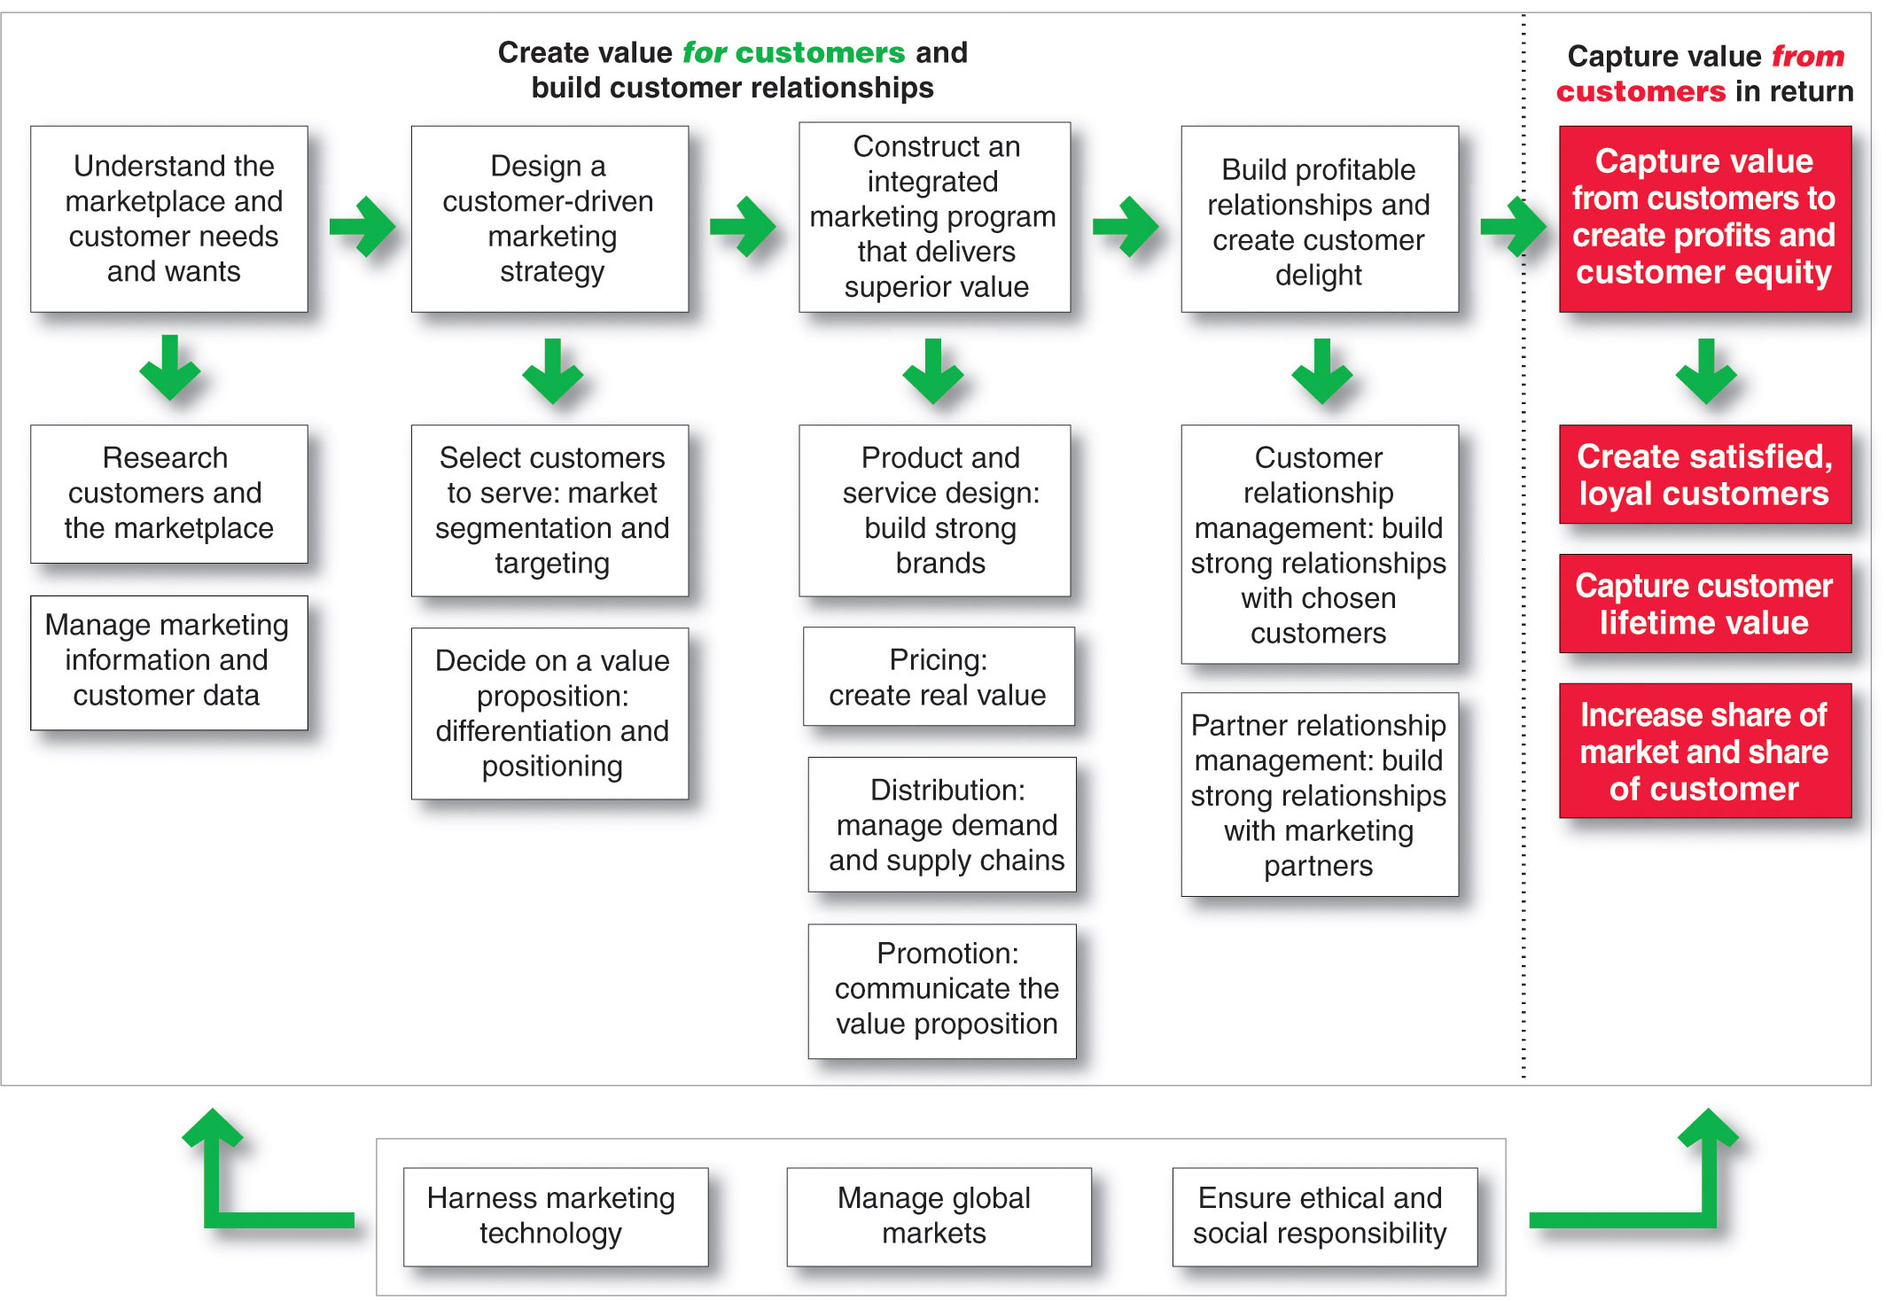
So, What Is Marketing?
Pulling It All Together

Slide 42
Five-Minute Drill
Identify a Firm…
  Discuss How Firm Provides Value to Customers
  Identify Three Ways in Which Customer Relationships Can Be Strengthened
  Work As If Your Job Depended On It!
Group Spokesperson “Report Back” to Class…

Slide 43
This Class
Intro
Pro Football 4 P’s
Creating and Capturing Customer Value (Chapter 1)
Five-Minute Drill

Slide 44
Preview of Next Class
Chapter 2 – Company and Marketing Strategy

